Slide 1
Data Structure
Course code: cs-201
Topic: Graphs data structure
Instructor: habiba arshad

Slide 2
Goals
Depth First Search

Slide 3
Depth First Search
Depth-first search: Strategy
Step1: Go as deep as can visiting un-visited nodes
Step 2: Choose any un-visited vertex when you have a choice put it in to the stack
Step 3: If stuck at a dead-end, backtrack as little as possible (pop top) Repeat the step 2
Back up to where you could go to another unvisited vertex
Then continue to go on from that point
Step 4: Eventually you’ll return to where you started

Slide 4
Applications of DFS
Depth-first search is used in topological sorting, scheduling problems, cycle detection in graphs, and solving puzzles with only one solution, such as a maze or a sudoku puzzle. Other applications involve analyzing networks, for example, testing if a graph is bipartite.

Slide 5
Depth-first searching
A depth-first search (DFS) explores a path all the way to a leaf before backtracking and exploring another path
For example, after searching A, then B, then D, the search backtracks and tries another path from B
Node are explored in the order A B D E H L M N I O P C F G J K Q
N will be found before J
A
B
C
D
E
F
G
H
I
J
K
L
M
N
O
P
Q

Slide 6
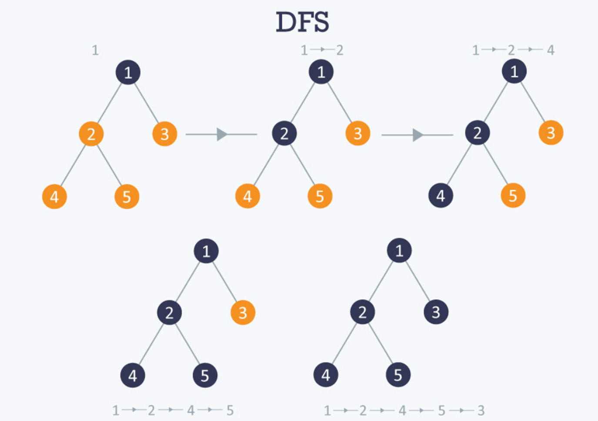
Depth First Search

Slide 7
DFS Algorithm
create a stack S
mark v as visited and push v onto S
while S is non-empty
peek at the top u of S
if u has an (unvisited)neighbour w,
mark w and push it onto S
else
pop S

Slide 8
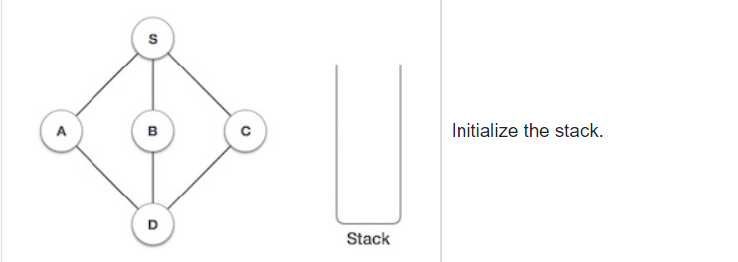

Slide 9
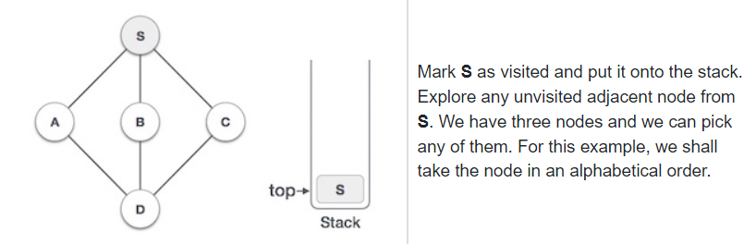

Slide 10
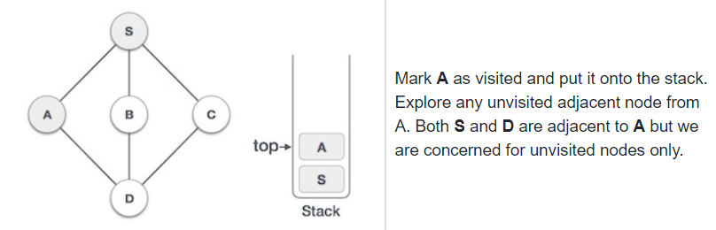

Slide 11
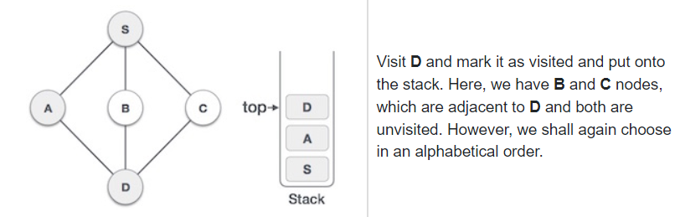

Slide 12
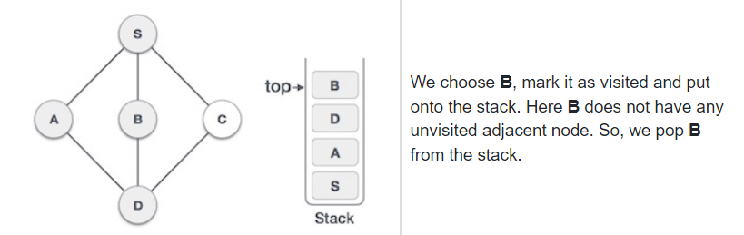

Slide 13
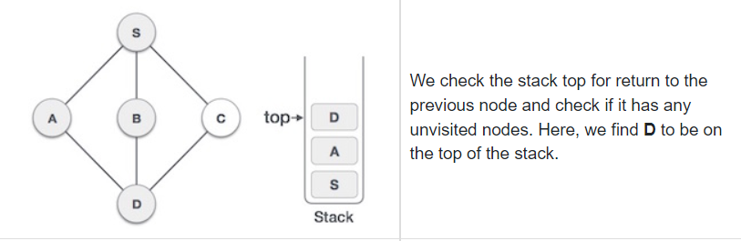

Slide 14
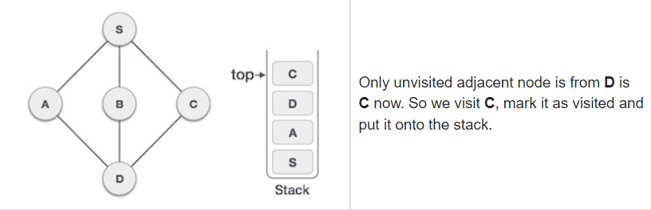
As C does not have any unvisited adjacent node so we keep popping the stack until we find a node that has an unvisited adjacent node. In this case, there's none and we keep popping until the stack is empty.

Slide 15
Undirected Depth First Search
A
H
I
B
C
G
Adjacency Lists
A: F C B G B: A C: A D: F E E: G F D F: A E D: G: E A: H: I: I: H:
D
E
F

Slide 16
Undirected Depth First Search
A
H
I
B
C
G
D
E
F newly discovered
F
visit(A)
(A, F) (A, C) (A, B) (A, G)
Undiscovered
Marked
Active
Finished
Stack

Slide 17
Undirected Depth First Search
A
H
I
A already marked
B
C
G
D
E
visit(F)
(F, A) (F, E) (F, D)
F
visit(A)
(A, F) (A, C) (A, B) (A, G)
Undiscovered
Marked
Active
Finished
Stack

Slide 18
Undirected Depth First Search
A
H
I
B
C
G
D
E
E
E newly discovered
visit(F)
(F, A) (F, E) (F, D)
F
visit(A)
(A, F) (A, C) (A, B) (A, G)
Undiscovered
Marked
Active
Finished
Stack

Slide 19
Undirected Depth First Search
A
H
I
B
C
G
G newly discovered
G
visit(E)
(E, G) (E, F) (E, D)
D
E
visit(F)
(F, A) (F, E) (F, D)
F
visit(A)
(A, F) (A, C) (A, B) (A, G)
Undiscovered
Marked
Active
Finished
Stack

Slide 20
Undirected Depth First Search
A
H
I
E already marked
visit(G)
(G, E) (G, A)
B
C
G
visit(E)
(E, G) (E, F) (E, D)
D
E
visit(F)
(F, A) (F, E) (F, D)
F
visit(A)
(A, F) (A, C) (A, B) (A, G)
Undiscovered
Marked
Active
Finished
Stack

Slide 21
Undirected Depth First Search
A
H
I
A already marked
visit(G)
(G, E) (G, A)
B
C
G
visit(E)
(E, G) (E, F) (E, D)
D
E
visit(F)
(F, A) (F, E) (F, D)
F
visit(A)
(A, F) (A, C) (A, B) (A, G)
Undiscovered
Marked
Active
Finished
Stack

Slide 22
Undirected Depth First Search
A
H
I
Finished G
visit(G)
(G, E) (G, A)
B
C
G
visit(E)
(E, G) (E, F) (E, D)
D
E
visit(F)
(F, A) (F, E) (F, D)
F
visit(A)
(A, F) (A, C) (A, B) (A, G)
Undiscovered
Marked
Active
Finished
Stack

Slide 23
Undirected Depth First Search
A
H
I
F already marked
B
C
G
visit(E)
(E, G) (E, F) (E, D)
D
E
visit(F)
(F, A) (F, E) (F, D)
F
visit(A)
(A, F) (A, C) (A, B) (A, G)
Undiscovered
Marked
Active
Finished
Stack

Slide 24
Undirected Depth First Search
A
H
I
B
C
G
D newly discovered
visit(E)
(E, G) (E, F) (E, D)
D
D
E
visit(F)
(F, A) (F, E) (F, D)
F
visit(A)
(A, F) (A, C) (A, B) (A, G)
Undiscovered
Marked
Active
Finished
Stack

Slide 25
Undirected Depth First Search
A
H
I
F already marked
visit(D)
(D, F) (D, E)
B
C
G
visit(E)
(E, G) (E, F) (E, D)
D
E
visit(F)
(F, A) (F, E) (F, D)
F
visit(A)
(A, F) (A, C) (A, B) (A, G)
Undiscovered
Marked
Active
Finished
Stack

Slide 26
Undirected Depth First Search
A
H
I
E already marked
visit(D)
(D, F) (D, E)
B
C
G
visit(E)
(E, G) (E, F) (E, D)
D
E
visit(F)
(F, A) (F, E) (F, D)
F
visit(A)
(A, F) (A, C) (A, B) (A, G)
Undiscovered
Marked
Active
Finished
Stack

Slide 27
Undirected Depth First Search
A
H
I
Finished D
visit(D)
(D, F) (D, E)
B
C
G
visit(E)
(E, G) (E, F) (E, D)
D
E
visit(F)
(F, A) (F, E) (F, D)
F
visit(A)
(A, F) (A, C) (A, B) (A, G)
Undiscovered
Marked
Active
Finished
Stack

Slide 28
Undirected Depth First Search
A
H
I
B
C
G
Finished E
visit(E)
(E, G) (E, F) (E, D)
D
E
visit(F)
(F, A) (F, E) (F, D)
F
visit(A)
(A, F) (A, C) (A, B) (A, G)
Undiscovered
Marked
Active
Finished
Stack

Slide 29
Undirected Depth First Search
A
H
I
D already marked
B
C
G
D
E
visit(F)
(F, A) (F, E) (F, D)
F
visit(A)
(A, F) (A, C) (A, B) (A, G)
Undiscovered
Marked
Active
Finished
Stack

Slide 30
Undirected Depth First Search
A
H
I
B
C
G
D
E
Finished F
visit(F)
(F, A) (F, E) (F, D)
F
visit(A)
(A, F) (A, C) (A, B) (A, G)
Undiscovered
Marked
Active
Finished
Stack

Slide 31
Undirected Depth First Search
A
H
I
C newly discovered
B
C
C
G
D
E
F
visit(A)
(A, F) (A, C) (A, B) (A, G)
Undiscovered
Marked
Active
Finished
Stack

Slide 32
Undirected Depth First Search
A
H
I
A already marked
B
C
G
D
E
visit(C)
(C, A)
F
visit(A)
(A, F) (A, C) (A, B) (A, G)
Undiscovered
Marked
Active
Finished
Stack

Slide 33
Undirected Depth First Search
A
H
I
B
C
G
D
E
Finished C
visit(C)
(C, A)
F
visit(A)
(A, F) (A, C) (A, B) (A, G)
Undiscovered
Marked
Active
Finished
Stack

Slide 34
Undirected Depth First Search
A
H
I
B newly discovered
B
B
C
G
D
E
F
visit(A)
(A, F) (A, C) (A, B) (A, G)
Undiscovered
Marked
Active
Finished
Stack

Slide 35
Undirected Depth First Search
A
H
I
A already marked
B
C
G
D
E
visit(B)
(B, A)
F
visit(A)
(A, F) (A, C) (A, B) (A, G)
Undiscovered
Marked
Active
Finished
Stack

Slide 36
Undirected Depth First Search
A
H
I
B
C
G
D
E
Finished B
visit(B)
(B, A)
F
visit(A)
(A, F) (A, C) (A, B) (A, G)
Undiscovered
Marked
Active
Finished
Stack

Slide 37
Undirected Depth First Search
A
H
I
G already finished
B
C
G
D
E
F
visit(A)
(A, F) (A, C) (A, B) (A, G)
Undiscovered
Marked
Active
Finished
Stack

Slide 38
Undirected Depth First Search
A
H
I
B
C
G
D
E
F
Finished A
visit(A)
(A, F) (A, C) (A, B) (A, G)
Undiscovered
Marked
Active
Finished
Stack

Slide 39
Undirected Depth First Search
A
H
I
B
C
G
D
E
F
Undiscovered
Marked
Active
Finished
Stack

Slide 40
Undirected Depth First Search
A
H
I
I
I newly discovered
B
C
G
D
E
F
visit(H)
(H, I)
Undiscovered
Marked
Active
Finished
Stack

Slide 41
Undirected Depth First Search
A
H
I
H already marked
B
C
G
D
E
visit(I)
(I, H)
F
visit(H)
(H, I)
Undiscovered
Marked
Active
Finished
Stack

Slide 42
Undirected Depth First Search
A
H
I
B
C
G
D
E
Finished I
visit(I)
(I, H)
F
visit(H)
(H, I)
Undiscovered
Marked
Active
Finished
Stack

Slide 43
Undirected Depth First Search
A
H
I
B
C
G
D
E
F
FinishedH
visit(H)
(H, I)
Undiscovered
Marked
Active
Finished
Stack

Slide 44
Undirected Depth First Search
A
H
I
B
C
G
D
E
F
Undiscovered
Marked
Active
Finished
Stack

